Slide 1
Final Project Breakdown

Slide 2
Rock Paper Scissors
So, this project, although doable with the skills you’ve been taught, was never meant to be very easy
It brings together most of the principles from today and adds to that the complexity of building a larger codebase
This presentation will run you through how I would have created this project myself
Disclaimer: there are a million different ways to do every task in programming. This is my way of doing it but there are definitely other good ways as well.

Slide 3
First Step: Understanding the brief
Whenever presented with a ”spec” or specification, we must break it down into its basic components to give us the best chance of success
So let’s run through each point in the spec and see what we learn
Project Guidelines:
1. The game will keep score
2. The game will let you stop whenever you want to
3. The game will prompt the player for a choice and respond with the computer’s choice randomly
The user input must be a string
The code must use a dictionary to map strings to ints
4. If the player inputs a bad input, the game will warn the player and continue
5. The entire game must be a function

Slide 4
1. The Game will keep Score
So this is a main consideration. How will the game keep score?
When I think of a value being stored, updated and output I think VARIABLE
Now given that it’s a score, it is probably an Integer (int)
We will need a variable for us, the player, and the computer
So now we see, this first requirement is asking us to instantiate 2 integer variables

Slide 5

1. The Game will keep Score (code)

Slide 6
2a. The game will let you stop whenever you want to
So here this tells me we need a variable which will keep track of whether we want to keep playing
This time we are looking for a True/False variable or a Boolean (bool)
So, this second requirement tells us to instantiate a Boolean variable to keep track of if we want to keep playing

Slide 7

2a. The game will let you stop whenever you want to (code)

Slide 8
2b. The game will let you stop whenever you want to
The second part of this requirement is realized that the game will keep going!
How do we make a task happen again and again? We use loops!
In my implementation I will use a while loop!

Slide 9
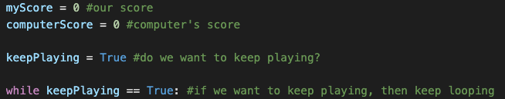
2b. The game will let you stop whenever you want to (code)

Slide 10
3a. The game will prompt the player for a choice
In the first half of this requirement, we will focus on prompting for a choice
In order for the game to prompt the player for a choice we will use the input commands
To store the input command, we must instantiate a variable as well!
We see that the requirement specifies a string so let’s use
”rock”
”paper”
”scissors”

Slide 11
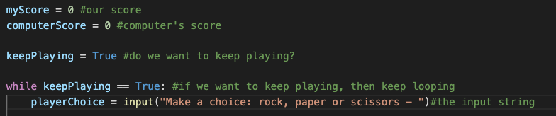
3a. The game will prompt the player for a choice

Slide 12
3b. The game will respond with a choice randomly
Now we have learned about random numbers but not about random strings…..how do we do this?
This is a great application for DICTIONARIES
We can essentially map integers (1,2,3) to words (“rock”, “paper”, “scissors”) to get the computer to make a choice randomly

Slide 13
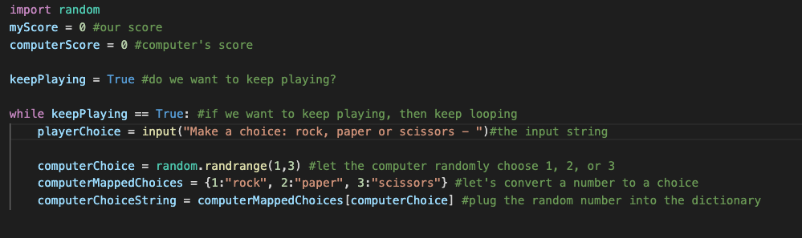
3b. The game will respond with a choice randomly (code)

Slide 14
Now What
So now in our code we have accomplished a lot
1. We can input a choice
2. The computer will make a choice
3. The game will keep looping
What do we have left?
1. Check for bad input
2. Calculate and output score
3. Ask if we want to keep playing
4. Make the game a function

Slide 15
4. If the player inputs a bad input, the game will warn the player and continue
We want to make sure the input is rock, paper or scissors not something weird or useless
So let’s make a check (if …. else seems useful)
The logic might be something like “if the input is not rock paper or scissors then output a warning”
We could even add a countdown for how many times we allow errors

Slide 16
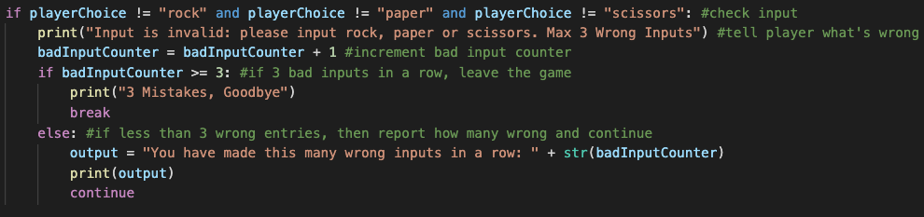
4. If the player inputs a bad input, the game will warn the player and continue (code)
This code comes between playerChoice and computerChoice

Slide 17
What do we have left
1. Check for bad input (done)
2. Calculate and output score
3. Ask if we want to keep playing
4. Make the game a function

Slide 18
Calculate and Output Score
This logic might be the most straightforward of the project (finally right)
We know how the game works so now let’s make a few conditionals to check who wins
So if player gets paper and computer gets rock, then player wins!
In this situation we add 1 to player score
Let’s account for all situations and adjust score accordingly

Slide 19
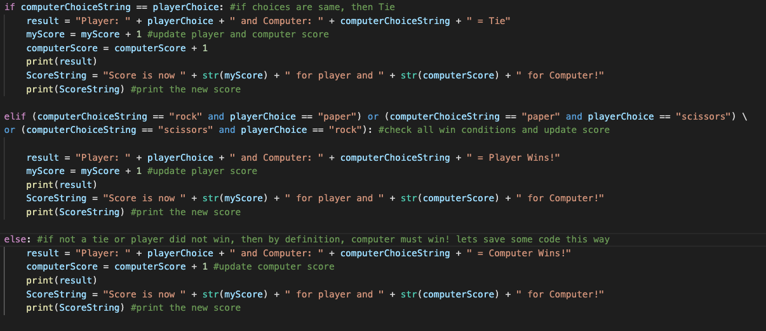
Calculate and Output Score (Code)

Slide 20
What do we have left
1. Check for bad input (done)
2. Calculate and output score (done)
3. Ask if we want to keep playing
4. Make the game a function

Slide 21
Ask if we want to keep playing
Because we set up the Boolean at the beginning this is easy
We just need to ask for input and then check if it is a yes or no!
If no, then the Boolean becomes False and the loop breaks

Slide 22
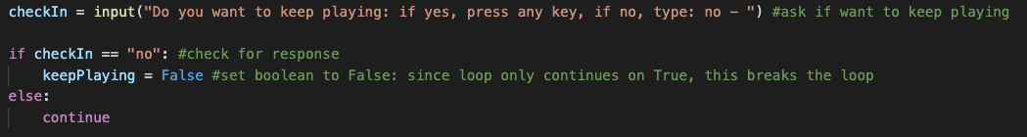
Ask if we want to keep playing (code)

Slide 23
What do we have left
1. Check for bad input (done)
2. Calculate and output score (done)
3. Ask if we want to keep playing (done)
4. Make the game a function

Slide 24
Make the game a Function
This requirement is more so that everyone has experience making a function in python
As we mentioned earlier, functions allow us to encapsulate tasks and use them very easily later on
To make this code a function, just add a def rps() after the import line and then indent every line 1 time
Then to run the code we must call the function later

Slide 25
Final Project Link
https://github.com/siddbose97/pythonWorkshop/blob/master/rps.py
At this link you can find the final code for this project
As I mentioned earlier, if you wish to contact me for help or any questions please reach out at siddbose97@gmail.com

